Slide 1
Optical Feedback and Laser Oscillation

Slide 2
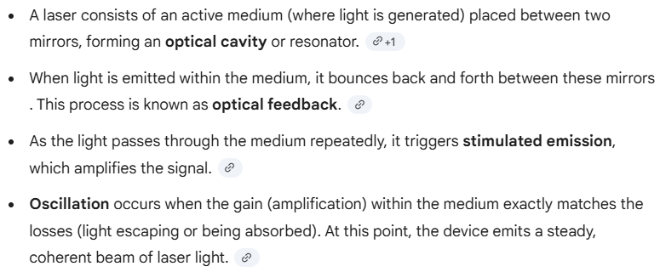
Mechanism of Optical Feedback:

Slide 3
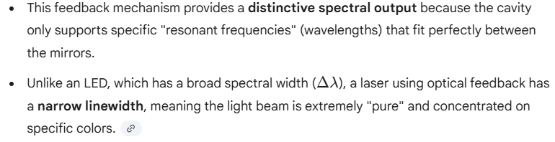
Spectral Output:

Slide 4
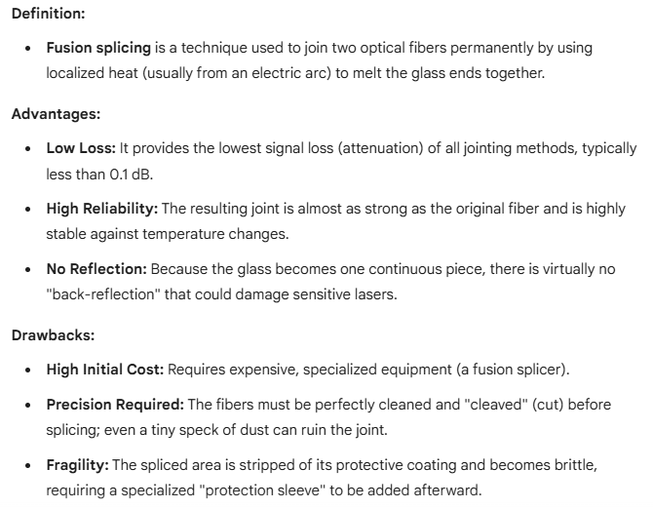
Fusion Splicing of Optical Fibers

Slide 5
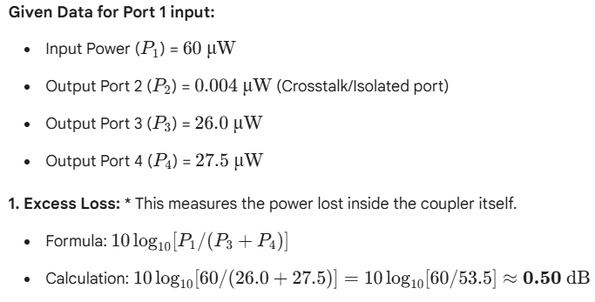
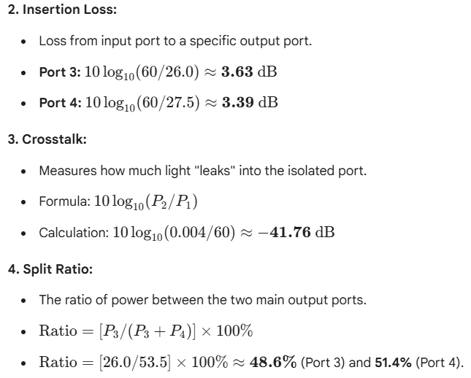
A four-port multimode fiber FBT coupler has 60 μW optical power launched into port 1. The measured output powers at ports 2, 3 and 4 are 0.004, 26.0 and 27.5 μW respectively. Determine the excess loss, the insertion losses between the input and output ports, the crosstalk and the split ratio for the device.

Slide 6
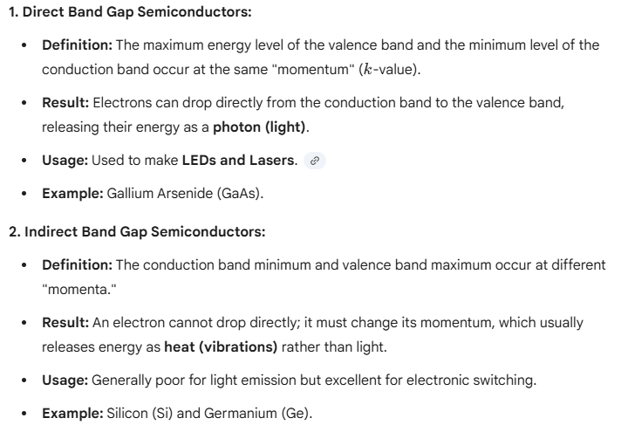
Direct and Indirect Band Gap Semiconductors
These terms describe how electrons move within a material to release energy (light)

